Slide 1
﻿Comparing Anomaly-Detection Algorithms for Keystroke Dynamics
﻿Final Project 4
Fall 2021
STAT 601
﻿Prepared By
Md Mominul Islam (101009250)

Slide 2
Outline
Background Study
Data Preview and Quick Analysis
Project Objective
Developed Algorithm
Exploratory Data Analysis
Statistical Model Development
Statistical Model Accuracy Summary
Project Conclusion
References

Slide 3
Background Study
Keystroke dynamics are patterns of rhythm created when a person types Keystroke dynamics which include Overall speed, Variations of speed moving between specific keys. [1]
These dynamics give us insights about authenticating the users and distinguishing the agent from the enemy.
Two researchers from CMU has conducted research about Keystroke dynamics to discriminate among users. [2]
Dr. Roy Maxian has proposed anomaly-detection algorithms for imposter detection and compared top performers (e.g., to identify promising research directions).
Dr. Maxian and with his colleagues recruited a group of 51 individuals who have typed a passcode for a specific system.
To have discreteness, Subjects completed 8 data-collection sessions (of 50 passwords each), for a total of 400 password-typing samples with at least one day rest in between.
With the collected real time keystroke dynamics data, finally developed an evaluation procedure

Slide 4
Project objective
Our prime objective is to detect authenticity of whether a user is consistent over time in typing a given passcode.
We will develop appropriate models along with exploratory data analysis using total password pressing time and three major features mentioned in Dr. Maxian’s paper.
Our model will be justified with proper statistical data analysis with reasonable presentation of the results.
In our final step, we will perform a post-hoc analysis testing the assumptions and accuracy of our model.

Slide 5
Data Preview and Quick analysis
Data set comprised of 51 subjects along with 31 pressing features.
Each subject has 400 repetitions of a password in 8 sessions.
There are two columns named ‘SessionIndex’ and ‘rep’ which are used to visualize our data in a good way.
Inspired from paper, we have sorted our data into Keydown-Keydown, Keydown-Keyup and Hold Press Time.
Keydown-Keydown: time between the key presses of consecutive keys is used as a feature. (DD.Time )
Keyup-Keydown: time between the release of one key and the press of the next is used. (UD.Time )
- Hold Time: Time between the press and release of each key is used. (Hold.Time)
We summed up the timing variables for each repetition during password input using rowsums() function and named it as TT.Time

Slide 6
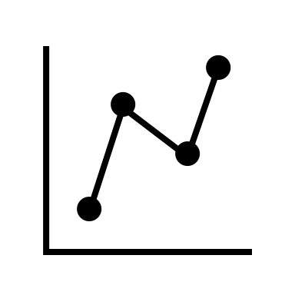

Developed Algorithm
Exploratory Analysis
Statistical Analysis
Model Development
Model Accuracy
Model Validation
In the First Part, We performed different EDA analysis. Correlation matrix to find correlation among different features, Mean Total Time vs Repetition Number of a Specific User, Summary Statistics of a User.
With our EDA, we have successfully analyzed consistency of a subject over time.
We have also tried to find any significant difference among randomly selected password input times of certain user.
Next, we developed a regression model based on Total Time of a random subject needed for every session to predict the total time needed for future sessions.
We have split our data into 70 % training data and 30% test data and train our model.
Lastly, we predicted and checked our results using test data.

Slide 7
Step 1: Exploratory analysis
Our main aim is to find authentic user or an imposter analyzing total time for per repetition and per session
BoxPlots, Histograms, Density Plots are used in finding major difference between sessions

Slide 8
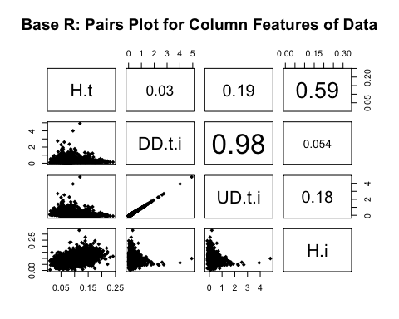
Correlation Matrix Among Feature Columns
 | H.t | DD.t.i | UD.t.i | H.i
H.t | 1.0000000 | 0.0297135 | -0.1888858 | 0.5894718
DD.t.i | 0.0297135 | 1.0000000 | 0.9759530 | -0.0536673
UD.t.i | -0.1888858 | 0.9759530 | 1.0000000 | -0.1812750
H.i | 0.5894718 | -0.0536673 | -0.1812750 | 1.0000000
A scatterplot matrix would be a nice way to represent a relationship among different features.
All other boxes display a scatterplot of the relationship between each pairwise combination of variables.
From our graph, we can say that Feature H.t and DD.t.i are positively correlated with a value of 0.03.
Here, DD.t.i and UD.t.i have the highest correlation with a value of 0.98.

Slide 9
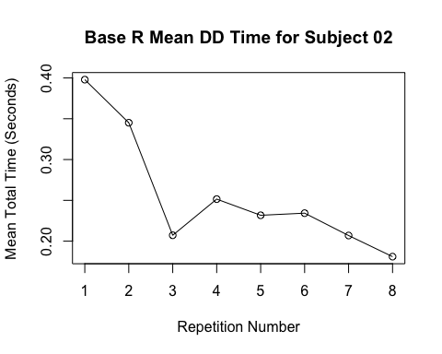
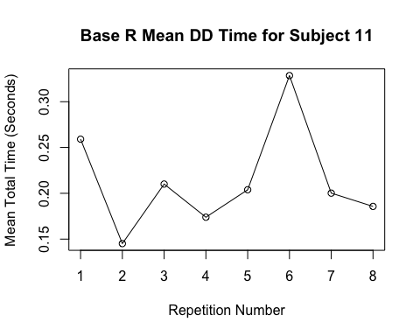
EDA of Keydown-Keydown Feature
We have selected two random user to check their pattern.
We have made plots based on Mean Total Time vs Repetition Number of subject 02 and subject 11.
If we see time at session 1 and session 8 of subject 2, the pressing time is reduced.
Users get used to pressing the similar password

Slide 10
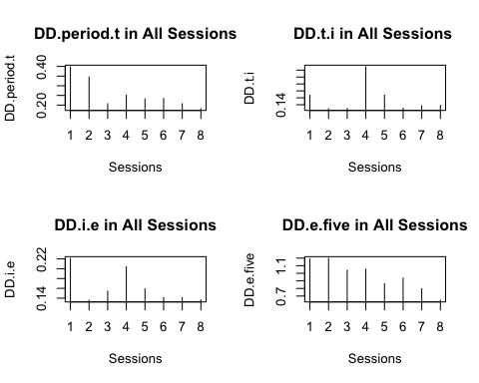
Base R plot of 8 Sessions of Subject 02
We have plotted features like DD.period.t, DD.t.i in Base R.
With successive session, pressing time is reduced
For an unknown user it would not be a same scenario.

Slide 11
Summary Statistics of Keydown-Keydown Feature
Keydown-Keydown: time between the key presses of consecutive keys is used as a feature. (DD.Time)
We combined all the DD terms and visualize them.
 | rep | DD.period.t | DD.t.i | DD.i.e | DD.e.five
Session1 | 1 | 0.3979 | 0.1674 | 0.2212 | 1.1885
Session2 | 2 | 0.3451 | 0.1283 | 0.1357 | 1.1970
Session3 | 3 | 0.2072 | 0.1291 | 0.1542 | 1.0408
Session4 | 4 | 0.2515 | 0.2495 | 0.2038 | 1.0556
Session5 | 5 | 0.2317 | 0.1676 | 0.1589 | 0.8629
Session6 | 6 | 0.2343 | 0.1299 | 0.1412 | 0.9373
Session7 | 7 | 0.2069 | 0.1368 | 0.1407 | 0.7967
Session8 | 8 | 0.1810 | 0.1378 | 0.1367 | 0.6447
We are considering only mean values of typing and recorded the mean values of down pressing time.
For the DD.period.t, when subject 2 typed for the first time, he/she took 0.3979 seconds and then for the 4th repetition, time was reduced to 0.2515 seconds and at 8th session time was only 0.1810.
With every session, subject 2 was more and more used to typing which suggests a definite pattern for subject 2. Same scenario is observed for the rest of the used columns.

Slide 12
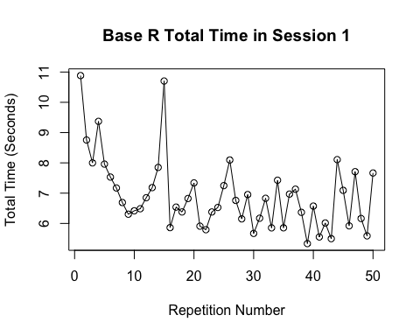
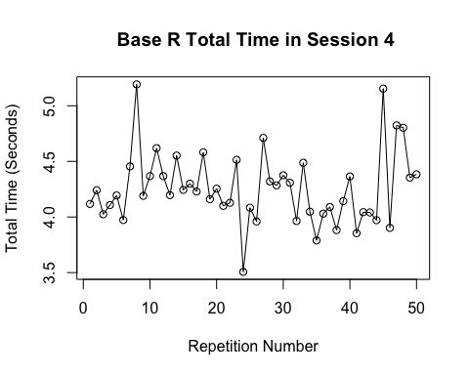
TOTAL TIME ANALYSIS OF SUBJECT 2 AT DIFFERENT SESSIONS
We have plotted our base R plotting using only one subject 02 and different session index like 1, 4 and 8.
With every session, total time is decreasing. We can see the proof of our analysis clearly from the graphs.
At the left graph, time range (Session 1) was in between 6~11 seconds but for the right graph (Session 4) time range was 3.5~5.0 Seconds.

Slide 13
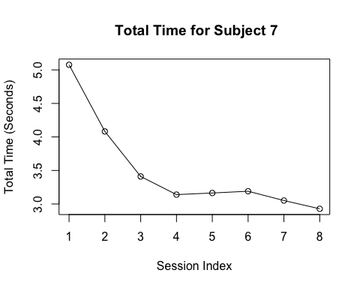
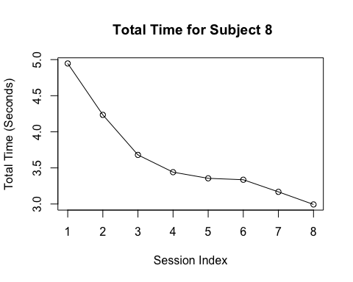
TOTAL TIME ANALYSIS OF different subjects
In this session, we have analyzed our data by taking total time and session index.
For an authentic user, total time got decreased at the last session.
We have selected two different users and plotted graph.
At session 8, average total time was around 3.0 Seconds for both

Slide 14
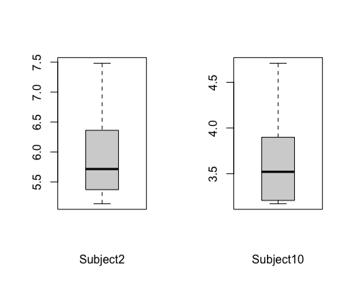
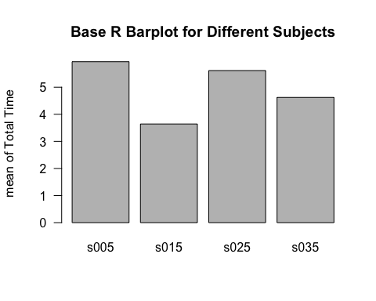
Boxplot and barplot for different users
Boxplot of subject 2 and 10. From this mean boxplot, we can say that data are normally distributed.
From the boxplot and barplot of different subjects, we can say that there is a variation in typing based on different users.

Slide 15
Statistical Model
Linear regression is used to predict the value of an outcome variable Y based on one or more input predictor variables X. The aim is to establish a linear relationship (a mathematical formula) between the predictor variable(s) and the response variable, so that, we can use this formula to estimate the value of the response Y, when only the predictors (Xs) values are known.
Here, we Developed a linear regression model for subject5. We took the average total time for password input for per session and the sessionIndex as the response variable.

Slide 16
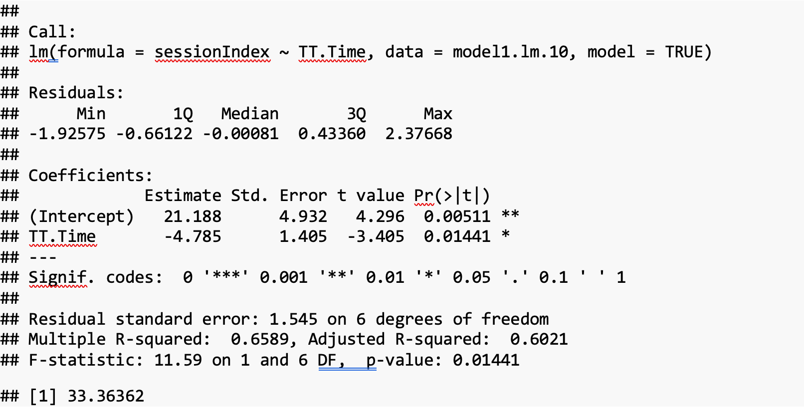
Linear Regression Model
In this session, we will develop a certain linear model for only one test subject.
We have chosen subject 10 for developing a regression model where we have taken the average of total time for password input for per session and the sessionIndex as the response variable.
 | Estimate | Std. Error | t value | Pr(>|t|)
(Intercept) | 21.187696 | 4.931837 | 4.296106 | 0.0051145
TT.Time | -4.785094 | 1.405471 | -3.404619 | 0.0144137
Here, the p-value is 0.01441 for TT.Time. We can reject null hypothesis.
The Akaike Information Criterion (AIC) provides a method for assessing the quality of our model through comparison of related models. Much like adjusted R-squared, it’s intent is to prevent us from including irrelevant predictors.
Our model with total time has AIC of 33.363

Slide 17
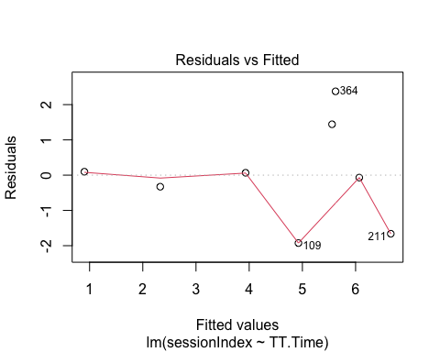
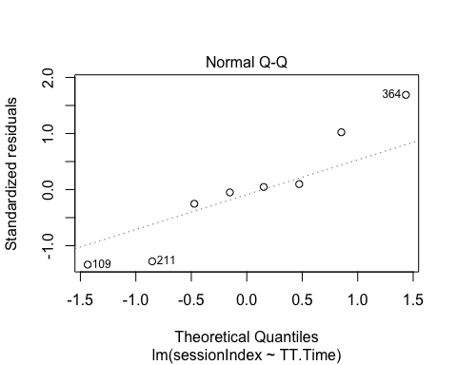
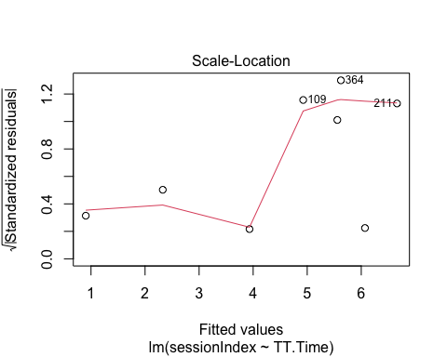
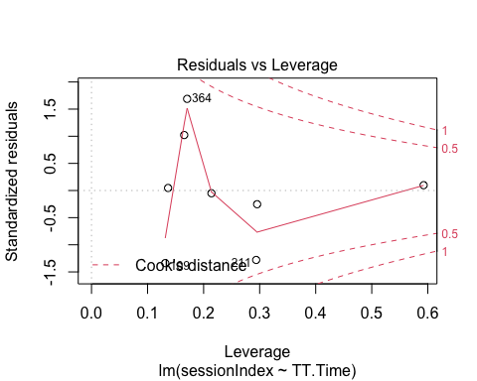
Linear Model Plotting
Residulas vs Fitted curve, suggests a linear patterns.
There could be a linear relationship between predictor variables and an outcome variable.
The Q-Q plot shows if residuals are normally distributed. Here the residuals follow a straight line well.
Scale-Location plot shows if residuals are spread equally along the ranges of predictors. This is how we can check the assumption of equal variance (homoscedasticity).
Residuals vs Leverage plot helps us to find influential cases. a case is far beyond the Cook’s distance lines (the other residuals appear clustered on the left because the second plot is scaled to show larger area than the first plot).

Slide 18
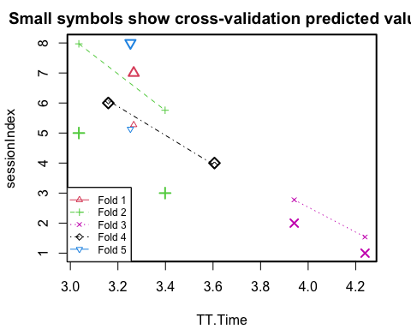
Accuracy Measurement
k- Fold Cross validation is used to compare different linear models.
K- Fold Validation Steps-
Split the data into ‘k’ mutually exclusive random sample portions.
Keeping each portion as test data, the model on the remaining (k-1 portion) data and
Calculate the mean squared error of the predictions.
The average of these mean squared errors (for ‘k’ portions) is computed.
we need to see if the lines of best fit don’t vary too much with respect the the slope and level.
From our plot we can see the dashed lines are parallel. Also the small and big symbols are not over dispersed for one particular color.

Slide 19
Multiple Linear Regression
Multiple regression is almost like a linear regression that takes into account the relationship between more than two variables.
We have one predictor and one response variable in a basic linear relationship, but we have many predictor variables and one response variable in multiple regression.
We may use DD time, UD time, and Hold time as predictor variables in a multiple linear regression with total time as the response variable.
For this, we build a subset of these variables from the data set.

Slide 20
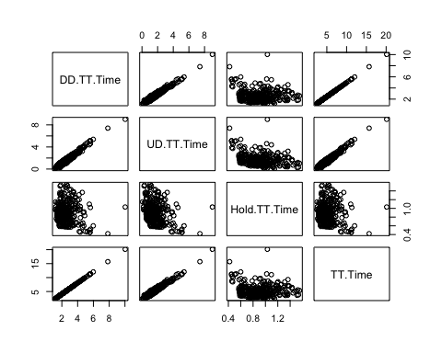
Multiple regression summary
 | Estimate | Std. Error | t value | Pr(>|t|)
(Intercept) | 0.0296641 | 0.0007816 | 37.95229 | 0
DD.TT.Time | 2.0694658 | 0.0007561 | 2736.85899 | 0
UD.TT.Time | -0.0720259 | 0.0007349 | -98.01399 | 0
From the plot, we can see both DD time and UD time are highly correlated to TT.time. On the other hand , hold time shows weak correlation with TT.time. Hence we can drop hold time from the regression model for improved result.

Slide 21
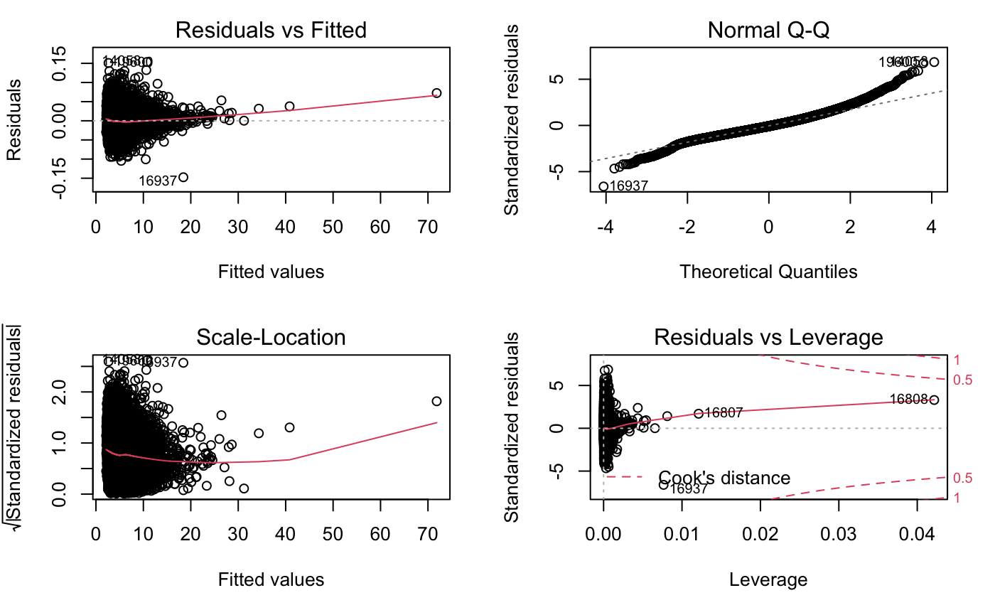
Multiple regression model plot
From the Residulas vs Fitted curve, we can see if residuals have non-linear patterns.
The Q-Q plot shows if residuals are normally distributed. Here the residuals follow a straight line well.

Slide 22
Conclusion
From our statistical Analysis, we can see that total time for one subject to put in the keystroke of designated password gradually changes with repetition and session. We have demonstrated the difference with graphical analysis such as plots, boxplot, histogram, density plots. Also, we performed a two tailed t.test to determine if there is a significant difference between the means of two groups.
Later, we demonstrated that there are total time differences for every subjects as the vary in mean total time.
Lastly, we developed a Linear Regression Model to predict the value of a dependent variable which is Total Time based on an independent variable. The greater the linear relationship between the independent variable and the dependent variable, the more accurate is the prediction.
We Also developed a multiple linear regression with total time as a response variable with DD time, UD Time and Hold time as predictor variables.

Slide 23
References
Xie, Yihui. 2015. Dynamic Documents with R and Knitr. 2nd ed. Boca Raton, Florida: Chapman; Hall/CRC. https://yihui.name/knitr/.
Kevin S. Killourhy and Roy A. Maxion. "Comparing Anomaly Detectors for Keystroke Dynamics," in Proceedings of the 39th Annual International Conference on Dependable Systems and Networks (DSN-2009), pages 125-134, Estoril, Lisbon, Portugal, June 29-July 2, 2009. IEEE Computer Society Press, Los Alamitos, California, 2009. (pdf - http://www.cs.cmu.edu/~keystroke/KillourhyMaxion09.pdf)
T. Sing, O. Sander, N. Beerenwinkel, T. Lengauer. "ROCR: visualizing classifier performance in R," Bioinformatics 21(20):3940-3941 (2005). (link - https://ipa-tys.github.io/ROCR/)
Fawcett, T. 2004. “ROC Graphs: Notes and Practical Considerations for Researchers.” In HPL-2003-4., 89–96. HP Labs, Palo Alto, CA.
Sing, Tobias, Niko Beerenwinkel, and Thomas Lengauer. 2004. “Learning Mixtures of Localized Rules by Maximizing the Area Under the Roc Curve.” In In et Al José Hernández-Orallo, Editor, 1st International Workshop on Roc Analysis in Artificial Intelligence, 89–96.
Plank, Barbara. "Keystroke dynamics as signal for shallow syntactic parsing." arXiv preprint arXiv:1610.03321 (2016).
Montalvao, Jugurta, Carlos Augusto S. Almeida, and Eduardo O. Freire. "Equalization of keystroke timing histograms for improved identification performance." 2006 International telecommunications symposium. IEEE, 2006.
https://appliedmachinelearning.blog/2017/07/26/user-verification-based-on-keystroke-dynamics-python-code/
https://www.cs.cmu.edu/~keystroke/#sec1
https://towardsdatascience.com/keystroke-dynamics-analysis-and-prediction-part-1-eda-3fe2d25bac04
https://towardsdatascience.com/keystroke-dynamics-analysis-and-prediction-part-2-model-training-a13dc353b6e4
https://www.kaggle.com/ashusrivastava/kda-on-benchmark
https://pandas.pydata.org/docs/getting_started/comparison/comparison_with_r.html
https://towardsdatascience.com/jypyter-notebook-shortcuts-bf0101a98330
https://github.com/kevinmgamboa/keystroke_dynamics/blob/master/keystroke_dynamics-Benchmark_kd.main_v1.ipynb

